Slide 1
Java Programming
Standard Input & output

Slide 2
Outline
Standard input & output
Standard Output
Class
Static attributes and functions
Dot notation
Formatting output
Standard Input
Package
Fully qualitied name
Object
Math functions

Slide 3
Standard input & output
Generally input is being given with the keyboard, and output is displayed on your screen.
Your keyboard is your "standard input" device, and the screen is the "standard output" device.

Slide 4
System.out.println
We saw these statements in previous chapter:
System.out.println(“Hello World!”)
System.out.println(10.5+(3-1)/(1+1));
System.out.println(str);
What is System ?
What is System.out ?
What is System.out.println ?

Slide 5
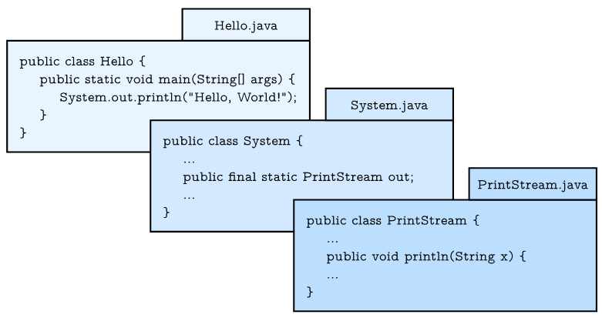
System.out.println

Slide 6
Class
Class is a type, but not a primitive type.
Class is a collection of attributes and methods (or subroutines)
Attributes are variables that can be accessed by the methods in the same class directly.
When a class contains static attributes or subroutines, we can access the static attributes or subroutines without declaration!
Java use dot notation to access the static attributes and methods.

Slide 7
System.out.println
Explanation:
Class System and PrintStream are provided by Java Library.
out is a static attribute of class System, and has the type PrintStream, we can use dot notation System.out to acess it.
println is a static method of class PrintStream. Similarly, we cam use dot notation System.out.println to invoke it.

Slide 8
Java Library
Java library has several thousand standard classes which provide frequently used functions, such as input, output, string operations, and math operations, etc.
When we need use the java library, we should import them in first, except for some frequently used classes, such as System, Math, Integer, Float, Double, Boolean, etc.

Slide 9
Conversion by method
int to String:
String five = 5; // ERROR!
String five = Integer.toString (5);
String five = “” + 5; // five = “55”
String to int:
int foo = “18”; // ERROR!
int foo = Integer.parseInt (“18”);

Slide 10
Formatting output
When you output a double using print or println, it displays up to 16 decimal places:
System.out.print(4.0 / 3.0);
The result is:
1.3333333333333333
That might be more than you want.

Slide 11
Formatting output
System.out provides another method, called printf, that gives you more control of the format. The “f” in printf stands for “formatted”. Here’s an example:
System.out.printf("Four thirds = %.3f", 4.0 / 3.0);
This format string contains ordinary text followed by a format specifier, which is a special sequence that starts with a percent sign. The result is:
Four thirds = 1.333

Slide 12
CalcArea.java (modified)
package hit.edu.java.intro;
pubic class CalcArea {
public static void main(String[] arguments) {
float r = 12.0F;
String str = “The circular area with radius ”;
str = str + r + “ is %.3f\n”;
System.out.printf(str, 3.1415926*r*r);
}
}

Slide 13
Format specifiers
Complete Form:
%[flags][width]conversion-code
Conversion code, e.g., %d for integer, %f for floating-point number, %c for character and %s for string.
Optional width can be inserted in between to specify the field-width.
Optional flag(-) can be used to control the alignment (default to the right, - means to the left).

Slide 14
Format specifiers
Note:
%α.βf is used to format the floating point number (float or double) printed in α spaces with β decimal digits (α and β are optional).
%n means a system-specific new line (Windows uses "\r\n", Unix and Mac "\n").

Slide 15
Observe the results
System.out.printf(“1234%3d6789%n", 5);
System.out.printf(“1234%-3d6789%n", 5);
System.out.printf("Hi,%s%n", “Trump!");
System.out.printf("Hi,%5s%n", “Trump!");
System.out.printf(“It’s %4.2f%n", 66.6666);
System.out.printf("It’s %.3f%n", 66.6666);

Slide 16
Input
The System class also provides the special value System.in, which is an InputStream that provides methods for reading input from the keyboard.
These methods are not easy to use; fortunately, Java provides class Scanner make it easier to handle common input tasks: inputting strings, integers, and other data.

Slide 17
Import statement
Before we can use Scanner, you have to import it like this:
import java.util.Scanner;
The import statement tells the compiler what classes will be used.
The import statements can’t be inside a class definition. They are at the beginning of the java file.
Note: If you omit the import statement and later refer to Scanner, you will get a compiler error like “cannot find symbol”.

Slide 18
Package & fully qualified name
Here java.util is not a variable in class, it is a package that contains many classes so useful they are called “utility classes”.
Java use fully qualified name (which is also a dot notation) to access the class in different packages.

Slide 19
Package
In Java, Package serves to group related classes hierarchically and define a namespace for the classes they contain.
To specify the package a class is to be part of, you use a package directive. The package keyword, if it appears, must be the first token of Java code.
Note: the java.lang package is imported automatically, so we can use the classes without importing them.
System, String and some other classes are in this package!

Slide 20
Fully qualified name
Every class has both a simple name, which is the name given to it in its definition, and a fully qualified name, which includes the name of the package of which it is a part.
The String class, for example, is part of the java.lang package, so its fully qualified name is java.lang.String.

Slide 21
Fully qualified name
The only way to use classes that belong to other packages without importing them is to use the fully qualified names of the classes in your code.
For example, the following code declares the java.io.File class using its fully qualified name.
java.io.File file = new java.io.File(filename);

Slide 22
Fully qualified name
If your class import identically-named classes from different packages, you must use the fully qualified names when declaring the classes.
For example, the Java core libraries contain the classes java.sql.Date and java.util.Date. In this case, you must write the fully qualified names of java.sql.Date and java.util.Date to use them.

Slide 23
HelloSomeone.java
package edu.hit.java.intro;
import java.util.Scanner;
public class HelloSomeone{ public static void main(String[] arguments) { Scanner in = new Scanner(System.in); String yourName= in.nextLine(); System.out.println(“Hello, ” + yourName); } }

Slide 24
java.util.Scanner
Here we declare a Scanner variable named in and creates a new Scanner that takes input from System.in which presents the keyboard.
Scanner provides a method called nextLine that reads a line of input (a string that ends with \n) from the keyboard and returns a String.
NOTE:
If we want to access the non-static attributes and methods, we must use the keyword new followed by a call to the class's constructor to instantiate an object, then use the dot notation to invoke them.
Object is an variable whose type is a class.

Slide 25
java.util.Scanner
Other methods in Scanner
nextLine
nextInt
nextshort
nextLong
nextDouble
nextFloat
nextBlooean
nextByte
…

Slide 26
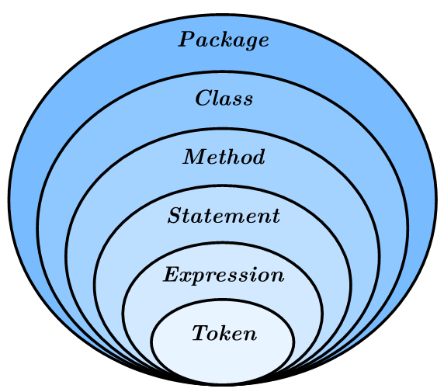
Java program structure
At this point, we have seen all of the elements that make up Java programs.

Slide 27
tokens
Tokens are the basic elements of a program, including keywords, literals, identifiers, operators, and punctuation marks.

Slide 28
CalcArea.java (modifed)
package edu.hit.java.intro;
import java.util.Scanner;
public class CalcArea{ public static void main(String[] arguments) { Scanner in = new Scanner(System.in); System.out.println(“what is the radius?”); float r = in.nextFloat(); String str = “The circular area with radius ”; str = str + r + “ is: %.3f\n”; System.out.printf(str, 3.1415926*r*r); } }

Slide 29
Magic numbers
The numbers like 3.1415926 appear in expression is called magic number.
If the same value appears many times, and might have to change in the future, it makes code hard to maintain.
A good practice is to assign magic numbers to constants with meaningful names.

Slide 30
CalcArea.java (modified)
package edu.hit.java.intro;
import java.util.Scanner;
public class CalcArea{ public static void main(String[] arguments) { final double PI = 3.1415926; Scanner in = new Scanner(System.in); System.out.println(“how many inches?”); float r = in.nextFloat(); String str = “The circular area with radius ”; str = str + r + “ is %.3f\n”; System.out.println(str, PI*r*r); } }

Slide 31
Constants
Variables declared as final are called constants. Constants cannot be reassigned once it has been initialized.

Slide 32
CalcArea.java (final version)
package edu.hit.java.intro;
import java.util.Scanner;
public class CalcArea{ public static void main(String[] arguments) { Scanner in = new Scanner(System.in); System.out.println(“how many inches?”); float r = in.nextFloat(); String str = “The circular area with radius ”; str = str + r + “ is %.3f\n”; System.out.println(str, Math.PI*r*r); } }

Slide 33
Math.PI
Math is a class of package java.lang
It provide some frequent used variables and methods. Most of them are static, so we can use them without declaration.
Math.PI is a static variable of double type, whose value is the circumference ratio π.

Slide 34
Methods and Constants in Math
methods
Math.abs
Math.cos
Math.sin
Math.tan
Math.ceil
Math.floor
Math.log
Math.sqrt
Math.round
Math.random
Math.min
Math.max
Math.pow
…
Constants
Math.PI
Math.E

Slide 35
The Scanner bug
System.out.print("What is your name? ");
name = in.nextLine();
System.out.print("What is your age? ");
age = in.nextInt();
System.out.printf("Hello %s, age %d\n", name, age);
Hello Grace Hopper, age 45

Slide 36
The Scanner bug
System.out.print("What is your age? ");
age = in.nextInt();
System.out.print("What is your name? ");
name = in.nextLine();
System.out.printf("Hello %s, age %d\n", name, age);
What is your name? Hello , age 45

Slide 37
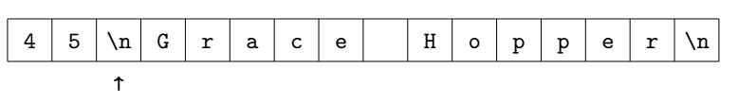
The Scanner bug
When you call nextInt, it reads characters until it gets to a non-digit.

Slide 38
Solve the Scanner bug
System.out.print("What is your age? ");
age = in.nextInt();
in.nextLine(); // read the newline
System.out.print("What is your name? ");
name = in.nextLine();
System.out.printf("Hello %s, age %d\n", name, age);

Slide 39
Quiz 2
Convert square feet to square meters:
we have known that 1 feet = 0.3048 meters.
input the square feet value and display the square meters value
Write a java class to solve this problem

Slide 40


